Slide 1
CSE 340 Computer Architecture Summer 2017 Basic MIPS Architecture Review
Notes:
Other handouts
To handout next time

Slide 2
The Processor: Datapath & Control
Our implementation of the MIPS is simplified
memory-reference instructions: lw, sw
arithmetic-logical instructions: add, sub, and, or, slt
control flow instructions: beq, j
Generic implementation
use the program counter (PC) to supply the instruction address and fetch the instruction from memory (and update the PC)
decode the instruction (and read registers)
execute the instruction
All instructions (except j) use the ALU after reading the registers
Fetch
PC = PC+4
Exec
Decode
Notes:
memory reference use ALU to compute addresses
arithmetic use the ALU to do the require arithmetic
control use the ALU to compute branch conditions.

Slide 3
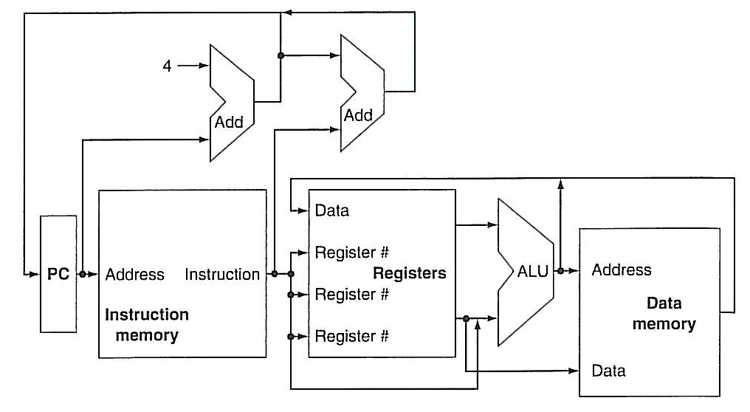
High-level view of MIPS implementation
The MIPS computer can address 4 Gbyte of memory, from address 0x0000 0000 to 0xffff ffff
User memory is limited to locations below 0x7fff ffff
Text (program) storage always starts at 0x0040 0000
Data storage always starts at 0x1001 0000

Slide 4
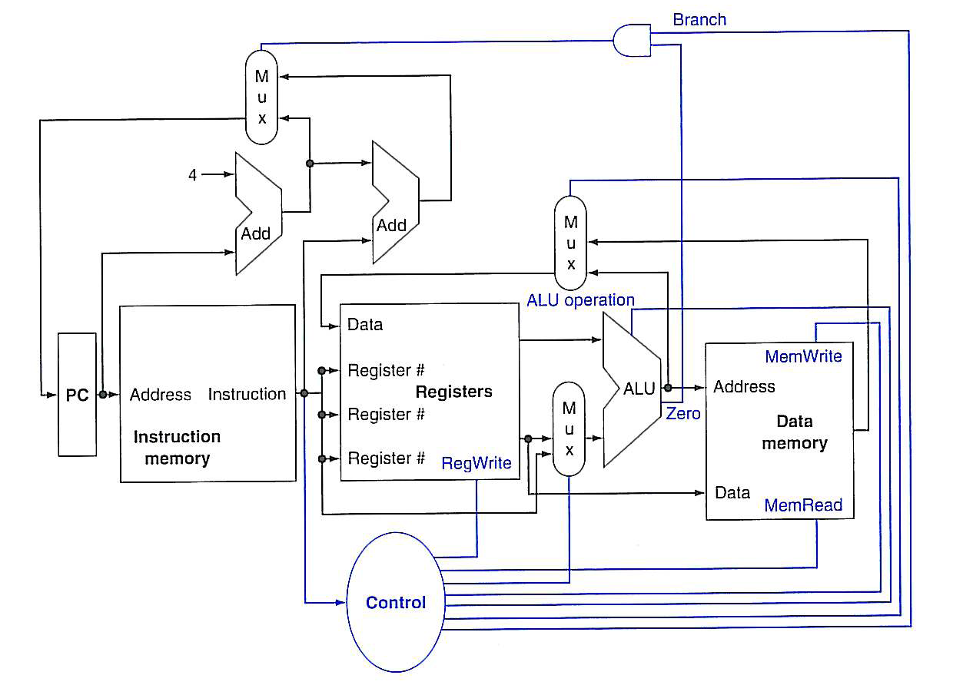
High-level view of MIPS implementation

Slide 5
Clocking Methodologies
The clocking methodology defines when signals can be read and when they are written
An edge-triggered methodology
Typical execution
read contents of state elements
send values through combinational logic
write results to one or more state elements
State
element
1
Combinational
logic
State
element
2
clock
one clock cycle
Assumes state elements are written on every clock cycle; if not, need explicit write control signal
write occurs only when both the write control is asserted and the clock edge occurs

Slide 6
Clocking Methodologies
Combinational element: The elements that operates on data values, which means their output deepens on the current inputs. Example: AND gate, ALU.
State Elements: An element that contains state as has some internal storage. A state element has at least two inputs and one output. Example: register, a memory.

Slide 7
Fetching Instructions
Fetching instructions involves
reading the instruction from the Instruction Memory
updating the PC to hold the address of the next instruction
Add
4
Instruction
Memory
PC
Read
Address
Instruction
PC is updated every cycle, so it does not need an explicit write control signal
Instruction Memory is read every cycle, so it doesn’t need an explicit read control signal

Slide 8
Decoding Instructions
Decoding instructions involves
sending the fetched instruction’s opcode and function field bits to the control unit
Control
Unit
Read Addr 1
Register
File
Read
Data 1
Instruction
Read Addr 2
Write Addr
Read
Data 2
Write Data
reading two values from the Register File
Register File addresses are contained in the instruction

Slide 9
Executing R Format Operations
R format operations (add, sub, slt, and, or)
perform the (op and funct) operation on values in rs and rt
store the result back into the Register File (into location rd)
31
25
20
15
10
5
0
R-type:
op
rs
rt
rd
shamt
funct
RegWrite
ALU control
Read Addr 1
Register
File
Read
Data 1
Instruction
Read Addr 2
overflow
ALU
zero
Write Addr
Read
Data 2
Write Data
The Register File is not written every cycle (e.g. sw), so we need an explicit write control signal for the Register File

Slide 10
Executing Load and Store Operations
Load and store operations involves
compute memory address by adding the base register (read from the Register File during decode) to the 16-bit signed-extended offset field in the instruction
store value (read from the Register File during decode) written to the Data Memory
load value, read from the Data Memory, written to the Register File
RegWrite
ALU control
MemWrite
overflow
Read Addr 1
zero
Register
File
Read
Data 1
Address
Instruction
Read Addr 2
Data
Memory
ALU
Read Data
Write Addr
Read
Data 2
Write Data
Write Data
Sign
Extend
MemRead
16
32

Slide 11
Executing Branch Operations
Branch operations involves
compare the operands read from the Register File during decode for equality (zero ALU output)
compute the branch target address by adding the updated PC to the 16-bit signed-extended offset field in the instr
Add
Branch
target
address
4
Add
Shift
left 2
ALU control
PC
Read Addr 1
zero
(to branch control logic)
Register
File
Read
Data 1
Instruction
Read Addr 2
Write Addr
ALU
Read
Data 2
Write Data
Sign
Extend
16
32

Slide 12
Executing Jump Operations
Jump operation involves
replace the lower 28 bits of the PC with the lower 26 bits of the fetched instruction shifted left by 2 bits
Add
4
4
Jump
address
Instruction
Memory
Shift
left 2
28
PC
Read
Address
Instruction
26

Slide 13
Creating a Single Datapath from the Parts
Assemble the datapath segments and add control lines and multiplexors as needed
Single cycle design – fetch, decode and execute each instructions in one clock cycle
no datapath resource can be used more than once per instruction, so some must be duplicated (e.g., separate Instruction Memory and Data Memory, several adders)
multiplexors needed at the input of shared elements with control lines to do the selection
write signals to control writing to the Register File and Data Memory
Cycle time is determined by length of the longest path

Slide 14
Fetch, R, and Memory Access Portions
Add
RegWrite
ALUSrc
ALU control
MemWrite
MemtoReg
4
ovf
zero
Instruction
Memory
Read Addr 1
Register
File
Read
Data 1
Address
Read Addr 2
Data
Memory
PC
Read
Address
Instruction
Read Data
Write Addr
ALU
Read
Data 2
Write Data
Write Data
MemRead
Sign
Extend
16
32

Slide 15
Adding the Control
Selecting the operations to perform (ALU, Register File and Memory read/write)
Controlling the flow of data (multiplexor inputs)
31
25
20
15
10
5
0
R-type:
op
rs
rt
rd
shamt
funct
Observations
op field always
in bits 31-26
addr of registers
to be read are always specified by the rs field (bits 25-21) and rt field (bits 20-16); for lw and sw rs is the base register
addr. of register to be written is in one of two places – in rt (bits 20-16) for lw; in rd (bits 15-11) for R-type instructions
offset for beq, lw, and sw always in bits 15-0
31
25
20
15
0
I-Type:
op
rs
rt
address offset
31
25
0
J-type:
op
target address

Slide 16
Single Cycle Datapath with Control Unit
0
Add
Add
1
4
Shift
left 2
PCSrc
ALUOp
Branch
MemRead
Instr[31-26]
Control
Unit
MemtoReg
MemWrite
ALUSrc
RegWrite
RegDst
ovf
Instr[25-21]
Read Addr 1
Instruction
Memory
Read
Data 1
Address
Instr[20-16]
Register
File
zero
Read Addr 2
Data
Memory
PC
Read
Address
Instr[31-0]
0
Read Data
1
Write Addr
ALU
1
Read
Data 2
0
Instr[15 -11]
Write Data
0
Write Data
1
Instr[15-0]
Sign
Extend
ALU
control
16
32
Instr[5-0]
Notes:
Note mux control inputs have been swapped (for three of the muxes) from the last picture to be consistent with the book.

Slide 17
R-type Instruction Data/Control Flow
0
Add
Add
1
4
Shift
left 2
PCSrc
ALUOp
Branch
MemRead
Instr[31-26]
Control
Unit
MemtoReg
MemWrite
ALUSrc
RegWrite
RegDst
ovf
Instr[25-21]
Read Addr 1
Instruction
Memory
Read
Data 1
Address
Instr[20-16]
Register
File
zero
Read Addr 2
Data
Memory
PC
Read
Address
Instr[31-0]
0
Read Data
1
Write Addr
ALU
1
Read
Data 2
0
Instr[15 -11]
Write Data
0
Write Data
1
Instr[15-0]
Sign
Extend
ALU
control
16
32
Instr[5-0]
Notes:
For lecture

Slide 18
Load Word Instruction Data/Control Flow
0
Add
Add
1
4
Shift
left 2
PCSrc
ALUOp
Branch
MemRead
Instr[31-26]
Control
Unit
MemtoReg
MemWrite
ALUSrc
RegWrite
RegDst
ovf
Instr[25-21]
Read Addr 1
Instruction
Memory
Read
Data 1
Address
Instr[20-16]
Register
File
zero
Read Addr 2
Data
Memory
PC
Read
Address
Instr[31-0]
0
Read Data
1
Write Addr
ALU
1
Read
Data 2
0
Instr[15 -11]
Write Data
0
Write Data
1
Instr[15-0]
Sign
Extend
ALU
control
16
32
Instr[5-0]

Slide 19
Load Word Instruction Data/Control Flow
0
Add
Add
1
4
Shift
left 2
PCSrc
ALUOp
Branch
MemRead
Instr[31-26]
Control
Unit
MemtoReg
MemWrite
ALUSrc
RegWrite
RegDst
ovf
Instr[25-21]
Read Addr 1
Instruction
Memory
Read
Data 1
Address
Instr[20-16]
Register
File
zero
Read Addr 2
Data
Memory
PC
Read
Address
Instr[31-0]
0
Read Data
1
Write Addr
ALU
1
Read
Data 2
0
Instr[15 -11]
Write Data
0
Write Data
1
Instr[15-0]
Sign
Extend
ALU
control
16
32
Instr[5-0]
Notes:
For lecture

Slide 20
Branch Instruction Data/Control Flow
0
Add
Add
1
4
Shift
left 2
PCSrc
ALUOp
Branch
MemRead
Instr[31-26]
Control
Unit
MemtoReg
MemWrite
ALUSrc
RegWrite
RegDst
ovf
Instr[25-21]
Read Addr 1
Instruction
Memory
Read
Data 1
Address
Instr[20-16]
Register
File
zero
Read Addr 2
Data
Memory
PC
Read
Address
Instr[31-0]
0
Read Data
1
Write Addr
ALU
1
Read
Data 2
0
Instr[15 -11]
Write Data
0
Write Data
1
Instr[15-0]
Sign
Extend
ALU
control
16
32
Instr[5-0]
Notes:
For class handout – have a student come forward and mark the connections in the datapath that are active. And show the state of the control lines.

Slide 21
Branch Instruction Data/Control Flow
0
Add
Add
1
4
Shift
left 2
PCSrc
ALUOp
Branch
MemRead
Instr[31-26]
Control
Unit
MemtoReg
MemWrite
ALUSrc
RegWrite
RegDst
ovf
Instr[25-21]
Read Addr 1
Instruction
Memory
Read
Data 1
Address
Instr[20-16]
Register
File
zero
Read Addr 2
Data
Memory
PC
Read
Address
Instr[31-0]
0
Read Data
1
Write Addr
ALU
1
Read
Data 2
0
Instr[15 -11]
Write Data
0
Write Data
1
Instr[15-0]
Sign
Extend
ALU
control
16
32
Instr[5-0]
Notes:
For lecture

Slide 22
Adding the Jump Operation
Instr[25-0]
1
Shift
left 2
28
32
26
0
PC+4[31-28]
Add
0
Add
1
4
Shift
left 2
Jump
PCSrc
ALUOp
Branch
MemRead
Instr[31-26]
Control
Unit
MemtoReg
MemWrite
ALUSrc
RegWrite
RegDst
ovf
Instr[25-21]
Read Addr 1
Instruction
Memory
Read
Data 1
Address
Instr[20-16]
Register
File
zero
Read Addr 2
Data
Memory
PC
Read
Address
Instr[31-0]
0
Read Data
1
Write Addr
ALU
1
Read
Data 2
0
Instr[15 -11]
Write Data
0
Write Data
1
Instr[15-0]
Sign
Extend
ALU
control
16
32
Instr[5-0]
Notes:
For lecture
Good exam questions
Add jalr rs,rd 0 rs 0 rd 0 9
jump to instr whose addr is in rs and save addr of next inst (PC+4) in rd
Add the PowerPC addressing modes of update addressing and indexed addressing (will have to expand the RegFile to be three read port and two write port)
Add andi, ori, addi - have to have both a signextend and a zeroextend and choose between the two, will have to augment the ALUop encoding (since can’t get the op information out of the funct bits as with R-type)
Add mult rs, rt with the result being left in hi|lo - so also include the mfhi and mflo instructions (will have to add a multiplier, the hi and lo registers and then a couple of muxes and their control).
Add barrel shifter

Slide 23
Single Cycle Disadvantages & Advantages
Uses the clock cycle inefficiently – the clock cycle must be timed to accommodate the slowest instruction
especially problematic for more complex instructions like floating point multiply
May be wasteful of area since some functional units (e.g., adders) must be duplicated since they can not be shared during a clock cycle
but
Is simple and easy to understand
Cycle 1
Cycle 2
Clk
lw
sw
Waste
Notes:
In the Single Cycle implementation, the cycle time is set to accommodate the longest instruction, the Load instruction.
Since the cycle time has to be long enough for the load instruction, it is too long for the store instruction so the last part of the cycle here is wasted.

Slide 24
Multicycle Datapath Approach
Let an instruction take more than 1 clock cycle to complete
Break up instructions into steps where each step takes a cycle while trying to
balance the amount of work to be done in each step
restrict each cycle to use only one major functional unit
Not every instruction takes the same number of clock cycles
In addition to faster clock rates, multicycle allows functional units that can be used more than once per instruction as long as they are used on different clock cycles, as a result
only need one memory – but only one memory access per cycle
need only one ALU/adder – but only one ALU operation per cycle

Slide 25
Multicycle Datapath Approach, con’t
At the end of a cycle
Store values needed in a later cycle by the current instruction in an internal register (not visible to the programmer). All (except IR) hold data only between a pair of adjacent clock cycles (no write control signal needed)
IR – Instruction Register MDR – Memory Data Register
A, B – regfile read data registers ALUout – ALU output register
Address
Memory
IR
A
PC
Read Addr 1
Read
Data 1
Register
File
Read Data
(Instr. or Data)
Read Addr 2
ALU
ALUout
Write Data
Write Addr
Read
Data 2
B
MDR
Write Data
Data used by subsequent instructions are stored in programmer visible registers (i.e., register file, PC, or memory)
Notes:
Have to add multiplexors in front of several of the functional unit inputs because the functional units are shared by different instruction cycles.
Reading/writing to
any of the internal registers or the PC occurs (quickly) at the end of a clock cycle
reading/writing to the register file takes ~50% of a clock cycle since it has additional control and access overhead (reading can be done in parallel with decode)

Slide 26
The Multicycle Datapath with Control Signals
PCWriteCond
PCWrite
PCSource
IorD
ALUOp
MemRead
Control
ALUSrcB
MemWrite
ALUSrcA
MemtoReg
RegWrite
IRWrite
RegDst
Instr[31-26]
PC[31-28]
Instr[25-0]
Shift
left 2
28
2
0
1
PC
0
Address
Memory
Read Addr 1
0
IR
Read
Data 1
A
1
Register
File
1
zero
Read Data
(Instr. or Data)
Read Addr 2
0
ALUout
Write Addr
ALU
Write Data
1
Read
Data 2
B
0
1
Write Data
4
MDR
1
0
2
Instr[15-0]
Sign
Extend
Shift
left 2
3
32
ALU
control
Instr[5-0]

Slide 27
Multicycle Control Unit
Multicycle datapath control signals are not determined solely by the bits in the instruction
e.g., op code bits tell what operation the ALU should be doing, but not what instruction cycle is to be done next
Must use a finite state machine (FSM) for control
a set of states (current state stored in State Register)
next state function (determined by current state and the input)
output function (determined by current state and the input)
Datapath
control
points
Combinational
control logic
. . .
. . .
. . .
State Reg
Inst
Opcode
Next State

Slide 28
The Five Steps of the Load Instruction
Cycle 1
Cycle 2
Cycle 3
Cycle 4
Cycle 5
lw
IFetch
Dec
Exec
Mem
WB
IFetch: Instruction Fetch and Update PC
Dec: Instruction Decode, Register Read, Sign Extend Offset
Exec: Execute R-type; Calculate Memory Address; Branch Comparison; Branch and Jump Completion
Mem: Memory Read; Memory Write Completion; R-type Completion (RegFile write)
WB: Memory Read Completion (RegFile write)
INSTRUCTIONS TAKE FROM 3 - 5 CYCLES!
Notes:
As shown here, each of these five steps will take one clock cycle to complete.

Slide 29
Multicycle Advantages & Disadvantages
Uses the clock cycle efficiently – the clock cycle is timed to accommodate the slowest instruction step
Multicycle implementations allow functional units to be used more than once per instruction as long as they are used on different clock cycles
but
Requires additional internal state registers, more muxes, and more complicated (FSM) control
Cycle 1
Cycle 2
Cycle 3
Cycle 4
Cycle 5
Cycle 6
Cycle 7
Cycle 8
Cycle 9
Cycle 10
Clk
lw
sw
R-type
IFetch
Dec
Exec
Mem
WB
IFetch
Dec
Exec
Mem
IFetch

Slide 30
Single Cycle vs. Multiple Cycle Timing
Single Cycle Implementation:
Cycle 1
Cycle 2
Clk
lw
sw
Waste
multicycle clock slower than 1/5th of single cycle clock due to state register overhead
Multiple Cycle Implementation:
Clk
Cycle 1
Cycle 2
Cycle 3
Cycle 4
Cycle 5
Cycle 6
Cycle 7
Cycle 8
Cycle 9
Cycle 10
lw
sw
R-type
IFetch
Dec
Exec
Mem
WB
IFetch
Dec
Exec
Mem
IFetch
Notes:
Here are the timing diagrams showing the differences between the single cycle and multiple cycle.
In the multiple clock cycle implementation, we cannot start executing the store until Cycle 6 because we must wait for the load instruction to complete.
Similarly, we cannot start the execution of the R-type instruction until the store instruction has completed its execution in Cycle 9.
In the Single Cycle implementation, the cycle time is set to accommodate the longest instruction, the Load instruction.
Consequently, the cycle time for the Single Cycle implementation can be five times longer than the multiple cycle implementation.

Slide 31
Next Lecture and Reminders
Next lecture
MIPS pipelined datapath review
Reading assignment – PH, Chapter 6.1-6.3

